Slide 1
Connectionism, Incommensurability and the Knowledge Argument.
By
William Angelette

Slide 2
According to one version of the knowledge argument, provided with a future completion of science, admitting the possibility of counting a new color perception as contributing to a justified, true, belief commits one to rejection of the mind-body identity theory.
Prior debate has been limited to traditional conceptions of knowledge. However, novel computer models of parallel distributed brain processes may offer fresh insight into the force of the knowledge argument.
I will demonstrate a series of ever more complex models that begin with two mutually constraining scientific values supposed to be functionally realized in human and animal brains.
I will suggest a neural mechanism underlying rationality and recast the knowledge argument in terms of an updated version of Kuhn’s Incommensurability thesis.

Slide 3
Three Lines of Thought
  The Knowledge Argument
    There’s Something About Mary
    Consensus from traditional debate
    the contested underlying assumption
  Scientific naturalism & the connectionist program
    Foundational issues
    Model virtues and limitations
  Incommensurability
    The early scientific revolutions view and the threat to rationality.
    The revised taxonomic view
    As developed within the connectionist paradigm
      Multi-domain incommensurability

Slide 4
Merging three lines of thought

Slide 5
The Knowledge Argument
There’s Something About Mary:
Mary is a brilliant scientist who is, for whatever reason, forced to investigate the world from a black and white room via a black and white television monitor. She specializes in the neurophysiology of vision and acquires, let us suppose, all the physical information there is to obtain about what goes on when we see ripe tomatoes, or the sky, and use terms like ‘red’, ‘blue’, and so on. She discovers, for example, just which wavelength combinations from the sky stimulate the retina, and exactly how this produces via the central nervous system the contraction of the vocal chords and expulsion of air from the lungs that results in the uttering of the sentence ‘The sky is blue’. (It can hardly be denied that it is in principle possible to obtain all this physical information from black and white television, otherwise the Open University would of necessity need to use color television.)
What will happen when Mary is released from her black and white room or is given a color television monitor? Will she learn anything or not? It seems just obvious that she will learn something about the world and our visual experience of it. But then it is inescapable that her previous knowledge was incomplete. But she had all the physical information. Ergo there is more to have than that, and Physicalism is false.
["Epiphenomenal Qualia" by Frank Jackson first appeared in Philosophical Quarterly, 32 (1982), pp. 127-36.]

Slide 6
The Knowledge Argument
Consensus from traditional debate:
Even Jackson he changes his mind in 2003.
The ability reply: on leaving the black-and-white room, Mary gains an ability without learning a new fact. Nemirow 1990 and Lewis 1990
The Fregian old-fact reply: Mary learns a fact she already knew under a new mode of presentation. Loar 1990
The acquaintance reply: Mary gains acquaintance with a property without learning new facts. Conee 1985
Failure of imagination view. Mary could know about color experience from inside her room. Dennett 2006

Slide 7
The Knowledge Argument
The underlying assumption explicit or implied in the knowledge argument debate :
A class of sentences,
true assertions,
reflect the body of justified beliefs
that compose the body of knowledge.

Slide 8
The Knowledge Argument
The Counting problem
    competing philosophical theories of meaning result in disagreement on the unit of meaning.
    Some even suggest that meanings ought to be abandoned.
.

Slide 9
The Knowledge Argument
The case of Mary gets its logic going by supposing that there is an easy way to count knowledge. In one column we stack the ‘bits’ of physical knowledge. In the other column we need to stack some other ‘bit’ and label the column, ‘other knowledge’. As long as it looks like there is a possibility to fill the second column with something it won’t matter how we did the individuation and counting . It seems, it will make sense to talk of more knowledge. Our next step, on this picture, might be to ask if the ‘bit’ we’re considering for the second column is a justified, true, belief (+ ) or is in some other sense knowledge.
Other
Physical Knowledge
Physical knowledge
Physical Knowledge

Slide 10
The Knowledge Argument
It was the wrong picture. Knowledge, so conceived, is a convenient fiction.
There is a glaring mismatch between that picture of knowledge and what we know about how brains work.
Knowledge does not lay waiting in a stack of possible assertions.
Suppose, as is supported by empirical evidence from neuro-psychology, that knowledge is a matter of continual processes of attention, and interaction with the environment, involving both retrieval, and construction.
This alternative picture now developing in neuro-psychology may better square with findings offered by connectionist cognitive science.

Slide 11
Scientific naturalism and the connectionist program
Foundational issues

Slide 12
Scientific naturalism and the connectionist program
Model virtues and limitations

Slide 13
The Affect-Reason-Utility Programs (ARU)
Simplicity and Explanatory Breath
Theory, Meta-Theory and Background Belief
Taxa, Language learning and Action (dthat)
Emotion, Methodological Values and Action
Harry’s Brain
Elisasmith’s Brain

Slide 14
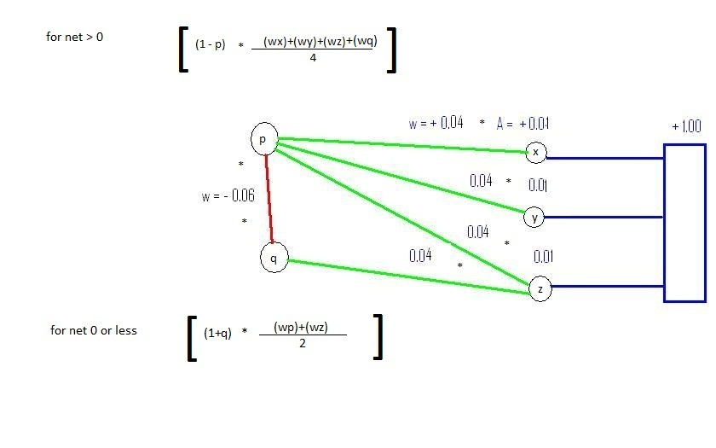
The Affect-Reason-Utility Programs (ARU)
Simplicity
Explanatory Breath
Neurons the wire together fire together raising activation levels in concert.
Two realizations of Simplicity:
Reason: Economy of Neurological Architecture
Affect – neurons plus endocrine system

Slide 15
The Affect-Reason-Utility Programs (ARU)
Theory - Hypothesis
Meta-Theory and Background Belief

Slide 16
The Affect-Reason-Utility Programs (ARU)
Taxa, Language learning and Action (dthat)

Slide 17
The Affect-Reason-Utility Programs (ARU)
Emotion
Methodological Values and Action

Slide 18
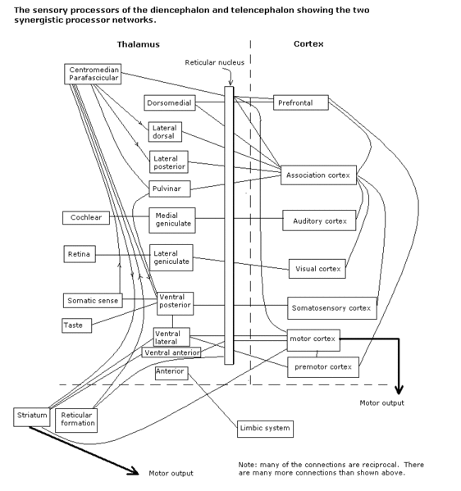
The Affect-Reason-Utility Programs (ARU)
Harry’s Brain
Methods….

Slide 19
Incommensurability
The early scientific revolutions view and the threat to rationality.
Incommensurability is not easily defined. Its root in the philosophy of science, borrowed from its use in mathematics, is found in Feyerabend (1962) and Kuhn (1962). Most simply, Incommensurability is captured by the slogan "having no common measure." Nearly fifty years of explication and modification of the common base found in this slogan have provided a rich tapestry of thought that is sometimes far removed from its origin. Howard Sankey (1994), as a first approach to his interpretation of semantic Incommensurability says,
to say that a pair of theories is incommensurable is to say that the theories do not share a common language or that the terms they employ do not have common meaning. . . . The languages of competing or successive theories in the same domain may differ with respect to the meaning, and even the reference, of their terms (p. 1).
The result will be failure of intertranslatablity. Such a result has been found to be unacceptable by commentators because it seems to make rational comparison of incommensurable theories impossible.

Slide 20
Incommensurability
The revised taxonomic view
In part to meet such objections, Kuhn refined his semantic conception of incommensurability by localizing the phenomenon to taxonomic differences between competing vocabularies,
To the extent that I'm concerned with language and with meanings at all . . . it is with the meanings of a restricted class of terms. Roughly speaking, they are taxonomic terms, a widespread category that includes natural kinds, artificial kinds, social kinds, and probably others. . . . If different speech communities have taxonomies that differ in some local area, then members of one of them can (and occasionally will) make statements that, though fully meaningful within that speech community, cannot in principle be articulated by members of the other (1991 p. 315).
On this version of semantic incommensurability, a basis for dialogue and comparison between competing theories is still possible because there are possibilities of translation in unaffected areas of the respective languages.

Slide 21
By contrast methodological incommensurability focuses upon the actions through which scientist acquire and maintain confidence in their theories. The methodological incommensurability thesis is the thesis that alternative scientific theories may be incommensurable due to absence of common standards of theory appraisal. In The Structure of Scientific Revolutions, Kuhn (1970) claimed that new theory acceptance is conditioned on preexisting methodological norms of evaluation, “There is no standard higher than the assent of the relevant community” (p.94). Standards of theory appraisal depend on and vary with the currently dominant scientific paradigm. Just in case methods of appraisal must vary between competing theories within a scientific domain such theories will have no common measure and thus be incommensurable. The rationality of scientific theory acceptance, it seems, depends upon shared objective standards of theory appraisal. But, the goals and desires that motivate methods of appraisal may vary without restriction.

Slide 22
Incommensurability
If we consider incommensurability as a subject of scientific study, it’s easy to see that to solve for semantic incommensurability one provides an appraisal method to study the semantic phenomenon. Connectionism opts for methods like logical analysis and neuro-computational modeling using parallel distributive processing. But, we immediately see that the rationality of the undertaking is compromised by the problem of methodological incommensurability unless a meta-methodological standard can be provided.

Slide 23
Conclusions further thoughts
  A plausible PDP explanation of belief justification in terms of coherence and information raises new challenges for defenders (and critics) of the knowledge argument that could not have been discovered otherwise. Specifically,
    Holistic and competitive information acceptance is better suited for grounding the knowledge argument because, it
      Comports with current mathematical and neurophysiological theory.
      Solves the ‘counting knowledge’ problem,
      Provides a means for dealing with the threat of incommensurability, and
      Suggests the possibility of un-mined alternative outcomes, e.g., the possibility of less knowledge.

Slide 24
Some practical outcomes
Possible teaching tools
Possible mental health treatments.

